Slide 1

Final Internship Presentation
Yashwant Yogi
(Mentor : Arash Agan)
9th August 2019, Cranston

Slide 2
My Background and Goals for internship
Academics:
2nd Year Masters in Mechanical Engineering at Purdue University
Specialization in Thermal-fluids with applications in variety of fields
Member of Warsinger Water Lab which works on Water treatment Technology
About me as an individual:
Nature loving person, environmentalist and optimistic.
Meet new people, understand their culture and way of thinking. This is my motivation for travelling.
Interested in Psychology, fiction books and philosophical conversations.
Family from Mumbai, India
Life Motivation
Application Based and Problem solving research
Work with People in industry and not just academia.
Apply my learnings of Two-phase flow, Thermodynamics and Heat Transfer.
New area of Application/ Field i.e. Fire Protection

Slide 3


Problem we are aiming to solve
Basic Problem definition
Need to know Mass flow rate, pressure, temperature of flow at any point of time and space.
Dimensions of Pipe networks (Diameter) and discharge nozzle diameter.
Simulation Software provided by third party.
Goal: To develop our own software.
Complex network of supply pipe line
Orifice/ Controller
Discharge Nozzle
Pressurized Cylinder with Fire extinguishing gas/Liquid
High pressurized fluid (up to 300bar)
To be discharged quickly( within 120s)
Complex pipe networks with combination of cylinders and Nozzles.
Gas Discharge
Displace O2
Room/ Space to be Fire protected,
e.g. Data centers, Server rooms, Museum.

Slide 4
Details and Goal of Project
Types of Systems
Inergen
Sapphire
52%
Nitrogen
3M Novec 1230 or dodecafluoro-2-methylpentan-3-one
Pressurized by Nitrogen and maintained in liquid state in cylinder.
2-phase problem/model, converts from Liquid state to gaseous state as it moves through the pipes
Difficult to model accurately.
Release time: max 10sec
Nitrogen
mixture of 52% Nitrogen, 40% Argon and 8% CO2.
Gaseous state in cylinder
One-phase problem/model or no conversion of phase.
Easier to model
Release time: upto 120sec
Novec
40% Argon
8% CO2

Slide 5
Execution Strategy
Complex network of supply pipe line
Nozzle
Orifice/ Controller
Simple to Complex
Cylinder-Valve (Numerical model)
Pipe network with Nozzles
Divide to solve
Start with simple system, 1 cylinder and 1 straight pipe with nozzle
Once Generalized Model created than add complexity.
Combine
Combine the two individually developed models to work as one
Compare with experimental results to make minute changes and improve accuracy.
Pressurized Cylinder with Fire extinguishing gas/Liquid

Slide 6
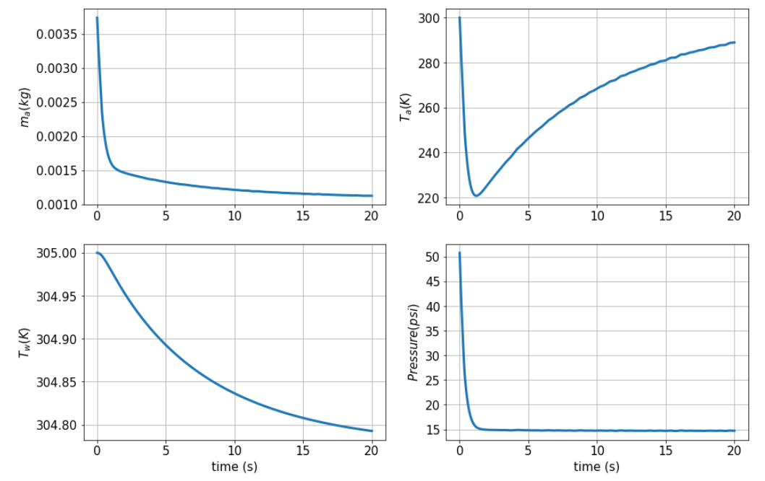
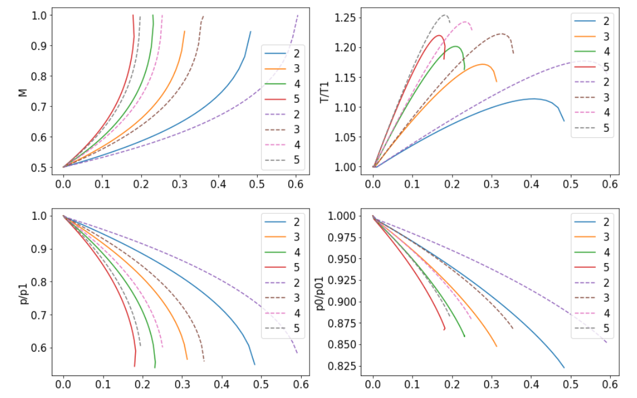
Important Milestones achieved
Tank/ pressurized container model
Model developed
Compared and matches with literature and our own experimental results
Heat transfer included
Variation in different parameters of tank and orifice can be easily done to observe variations
Straight pipe network model
Different types of models developed working on different algorithms
Most generalized model ready.
Heat transfer through pipe included.
Two types: Constant Wall temperature and Constant heat flux

Slide 7
Other Milestones
Model for discharge nozzle developed
Conversion module developed for converting output parameters of one part to input friendly parameters for next part.
Pipe network
Output parameters (stagnation Pressure, mass flow rate)
Discharge nozzle
(Mach no., Stagnation temperature)
Conversion module
Validation of developed model
To validate the model developed by us we need to compare it with experimental observations and result.
Once our results match with the experimental observations up to some accuracy it can be further improved by repeated process of making minute changes in the model till the difference lowers down to acceptable value.
Issue due to I-flow valve on the cylinders

Slide 8
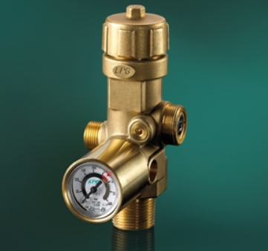
I-flow valve( pressure regulator valve)
Speciality:
Varying diameter of opening to regulate pressure downstream
Prevents sudden blowdown of gas/fluid i.e. pressure downstream in the manifold is controlled below a safe value( 60 bar).
Issue:
Opening size varies with cylinder pressure and time, making it difficult to calculate the effective diameter and code it in our model.
Logic to measure the effective diameter:
Use experimentation results where I-flow valve is totally open and doesn’t close the opening to reduce the pressure downstream.
From all the experimentation results it was observed that one of the witness tests (764_wit_mod) matches our requirements.
By approximately matching the curves(readings of back pressure in the manifold and mass of cylinder) reverse calculations were done.
Approximate effective opening area of I-flow valve found
Pipe Manifold
I-flow valve as orifice
Pressurized Cylinder

Slide 9
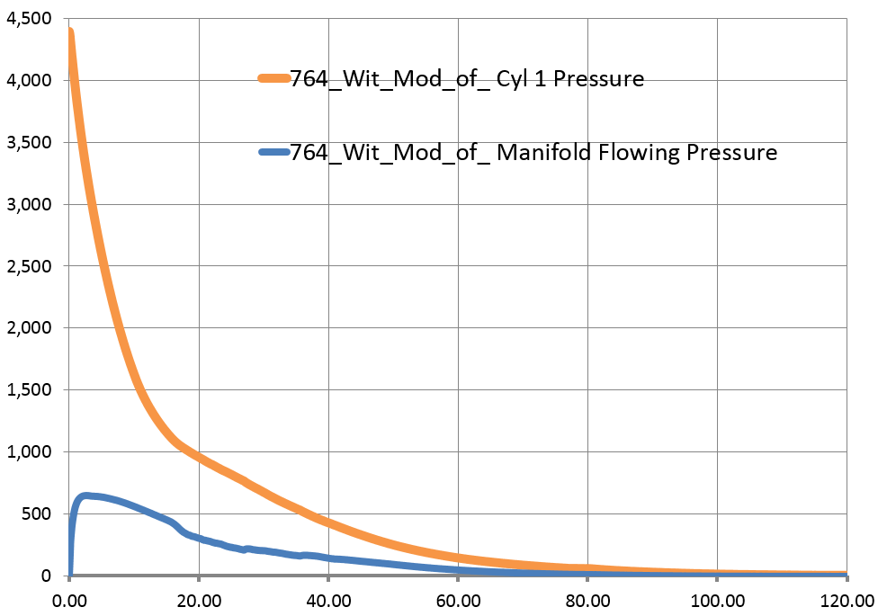
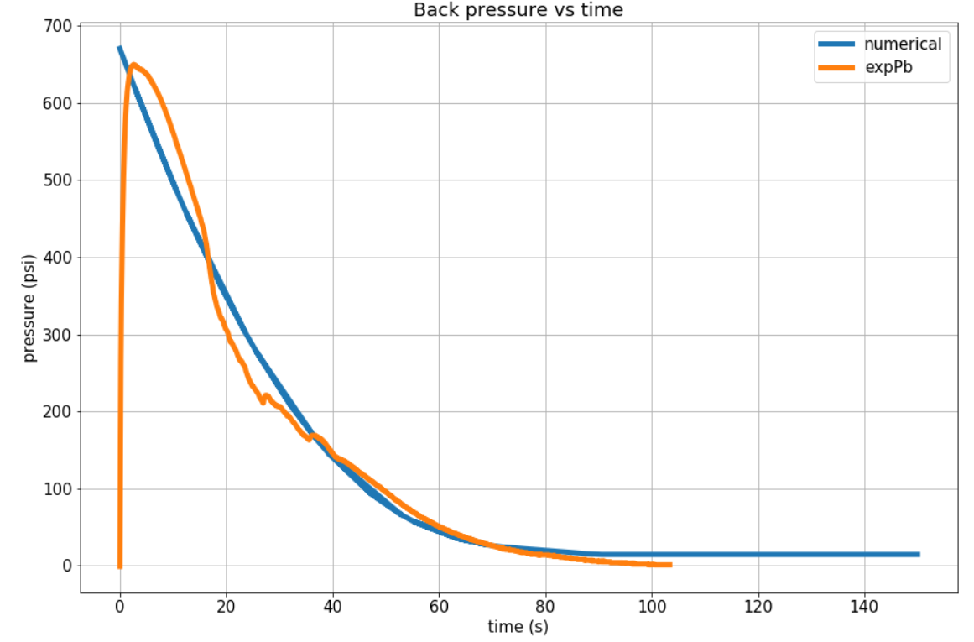
Understanding Experimental Result
Pressure (psi)
Time (sec)
Pressure vs Time observation for 764_Wit_Mod
Matching the observation with equivalent mathematical equation.

Slide 10
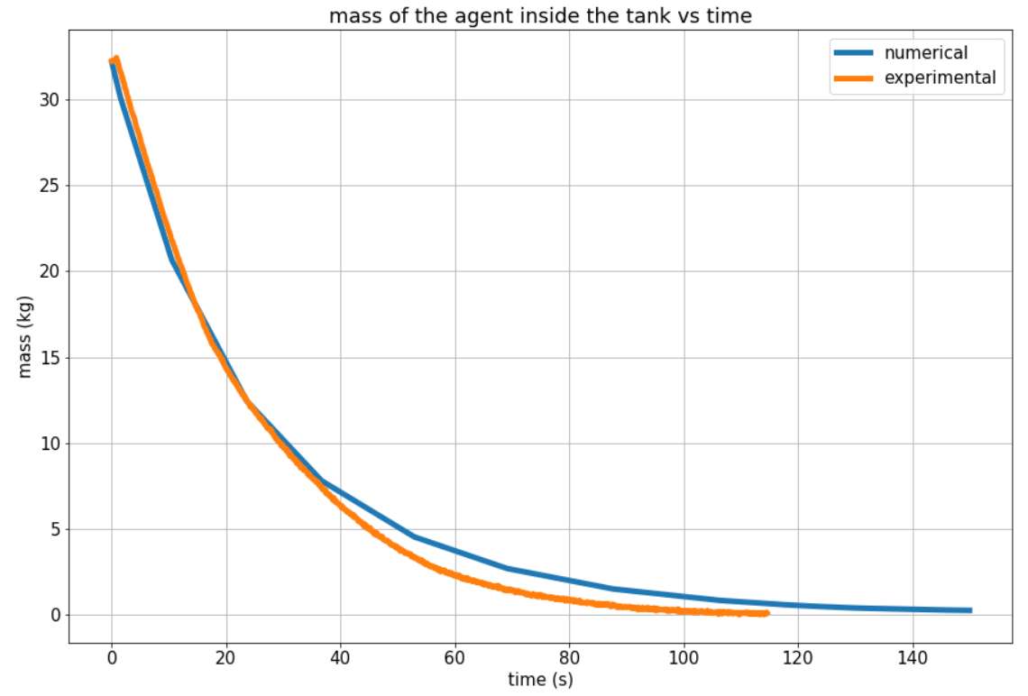
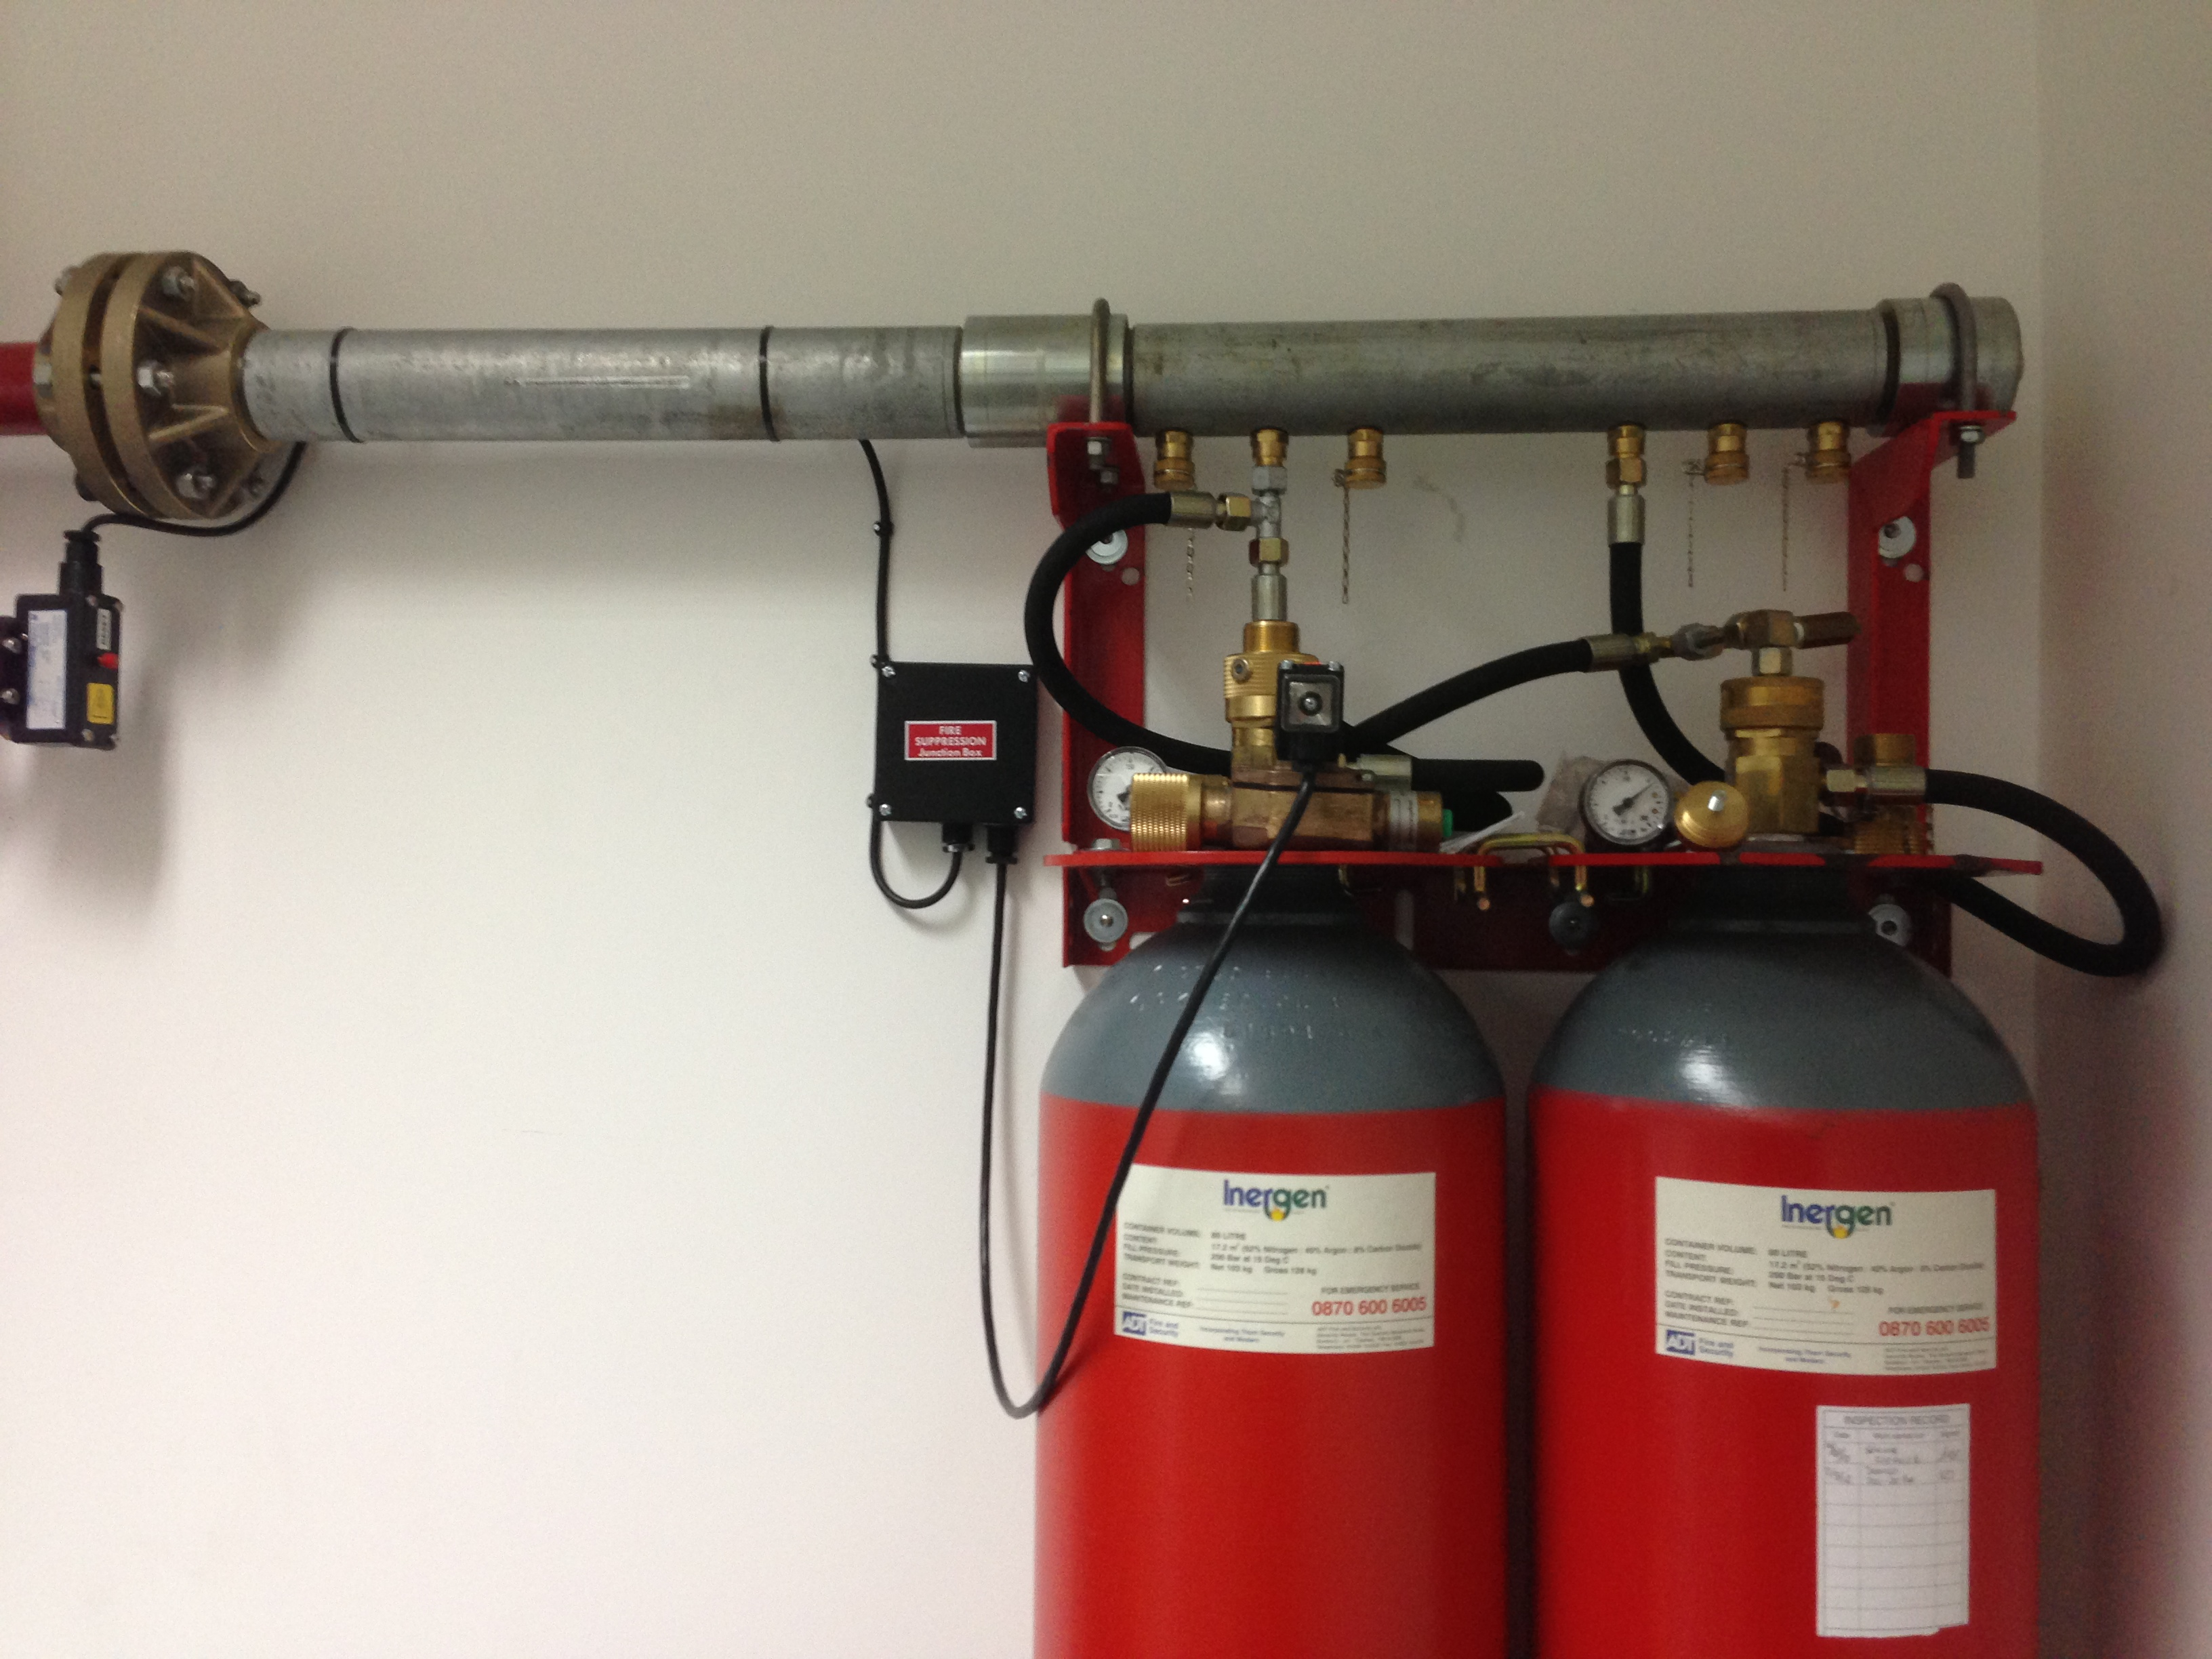
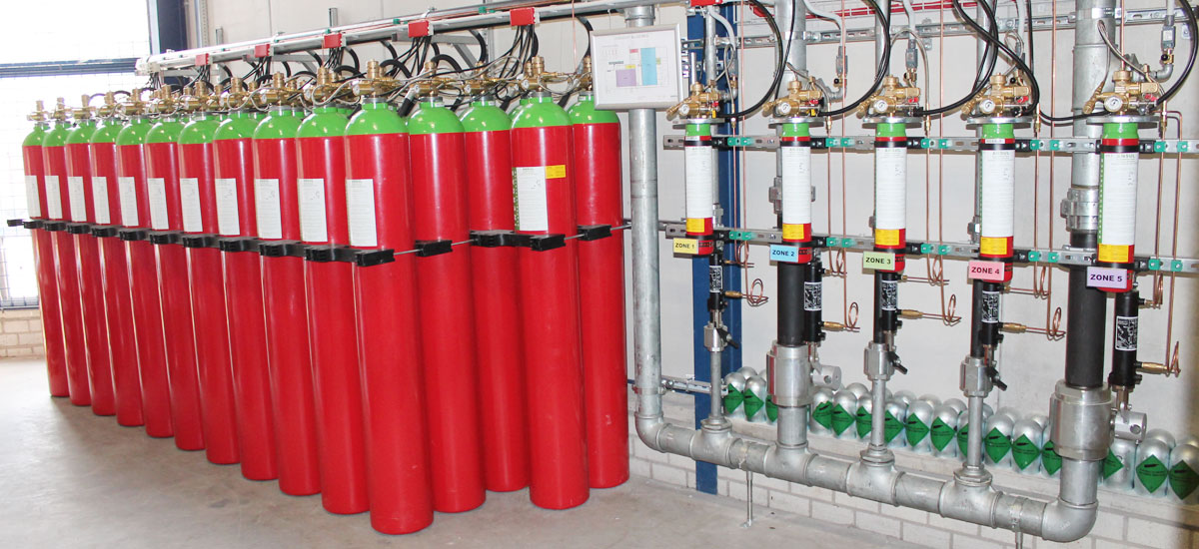
Match found
We already know back Pressure varying with time.
We varied the effective diameter of I-flow valve opening till the mass from the numerical model matched with the experimental Mass of agent inside the tank
Our model now allows us to even model the I-flow nozzle
Simple network
Complex networks

Slide 11
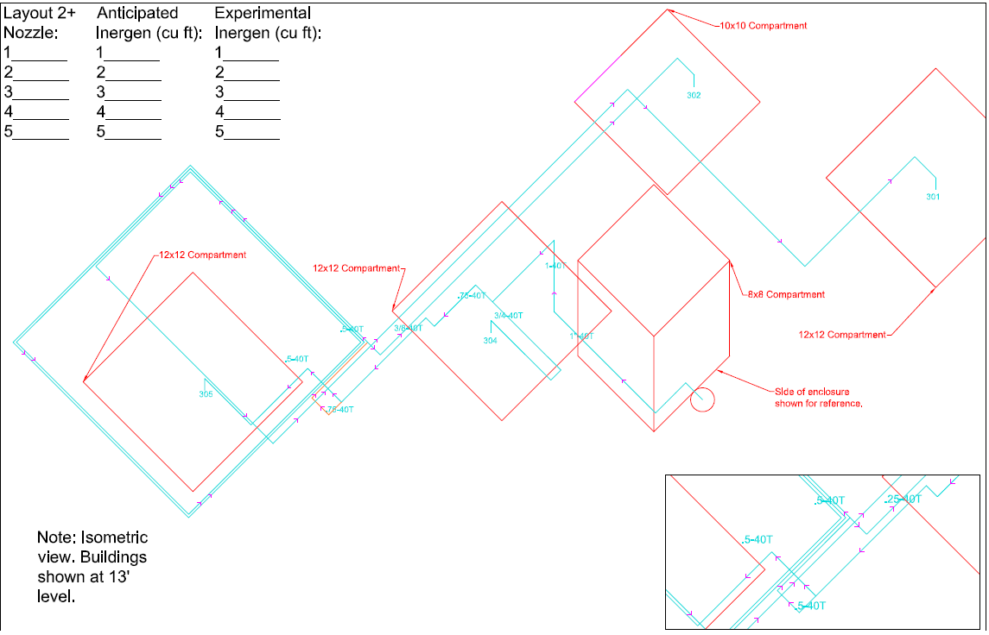
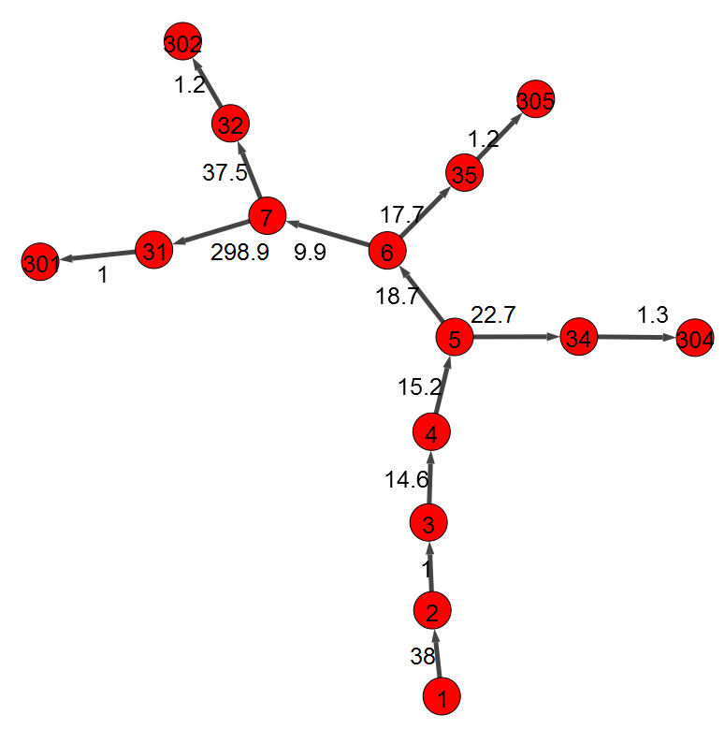
Complex Network conversion to computer friendly model
Schematic (Isometric view) of a real system (764_Wit_mod_of_UL2) which was tested
Network model that computer can understand

Slide 12
Iterations and Results
Filled in the graphical complex network
Pressurized cylinder
Pipe network
Nozzles and orifice
Output: Mass flow rate, pressure, temperature of flow at any point of time and space in the network.
Helps in suggesting pipe network diameter, discharge nozzle diameter.
Iterative method
Presently doing this

Slide 13
Conclusion and Future scope
Inergen system
In next one week we will finish the iterative model and we will have a complete running model for the Inergen system
Conclusion:
Company has its own model and no need to depend on third party software.
More flexibility in designing and implementing more complex networks.
More optimized and cost effective systems can be designed.
Sapphire System
For Sapphire System (NOVEC) we can use the base of Inergen Model making it’s development easier
Release on website
Release both the models on the server (website) for user use and guidance.

Slide 14
Thank you!
Special Thanks to Arash
Thanks to Zach, Pepi, Cassie and the entire Innovation team.
Thanks to Emma, Armando!

Slide 15
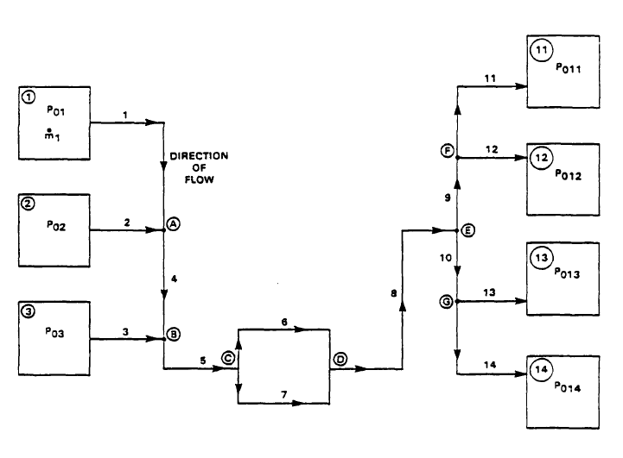
Example of iteration method
Rooms/ Nozzle
Find furthest tank and common point
Assume mass flow rate from furthest tank
Equalize Stagnation pressure at each T-junction till common point in Forward pass.
Reverse calculate the stagnation Pressure at common point in the backward pass for network downstream of the common point.
Change the assumed mass till the stagnation pressure match at the common point.
This procedure done for each time step ‘dt’
Gas tanks

Slide 16
Problem and our Solution
Third Party Software
Our own software
Code or how it works not known
Works best only in certain range of parameters like flow rate and pressure
Assumptions like adiabatic Pipe and tank
High Factor of Safety, less flexible to changes. (Specific pressure only, size etc.)
Our Installation capabilities are limited due to this software even when we are more capable.
Need to pay
Even small Modifications needs involvement of third party.
Code and working will be known
Will work in broader range of different parameters.
Heat transfer across pipe and tank considered giving more accurate results.
Factor of Safety as per requirement which will provide more flexibility.
Limitations on Installation capabilities will decrease.
Home-made software so one time investment.
Continuous Improvement.

Slide 17
Challenges in achieving the Goal
Limited literature
Literature available that can help us model this systems is sparse and hard to find.
We depend highly on old research papers which present the basic idea to solve such problems.
Smaller runtime requirement prevents use of Computational Fluid dynamics so need to rely on analytical solutions that give quick results.
Limited literature to compare the output of our models so need to rely on our own experimentation results.
Content/Literature available is between the lines and need more efforts and time to fill in between and use it to develop our model.
Time
Reading literature and understanding it to code and develop a software model and then debug & test it to get accurate results involves lot of time.
Priority given to Inergen and then move to Sapphire (Novec)

Slide 18
Work in progress & Next steps
Combine the models
Defining the pipe network as a data structure.
Complex pipe network
Combine the Tank and pipe models for Simple system
NOVEC
Use the base of Inergen Models and develop model for NOVEC (2-phase flow)
Model for Iteration in such complex network (already found and understood)
Supporting literature read but yet more research needed.
Improve accuracy for different range of input parameters.
Developing an algorithm to design a pipe network that satisfies the NFPA requirements.

